Slide 1
leadership
https://study.com/academy/lesson/leadership-styles-and-types-authoritarian-laissez-faire-democratic.html
https://en.wikipedia.org/wiki/Leadership_style#Democratic

Slide 2
leadership
providing directions
implementing plans
motivating people

Slide 3
social groups: benefits
instrumental
& task reasons
→ accomplice

Slide 4
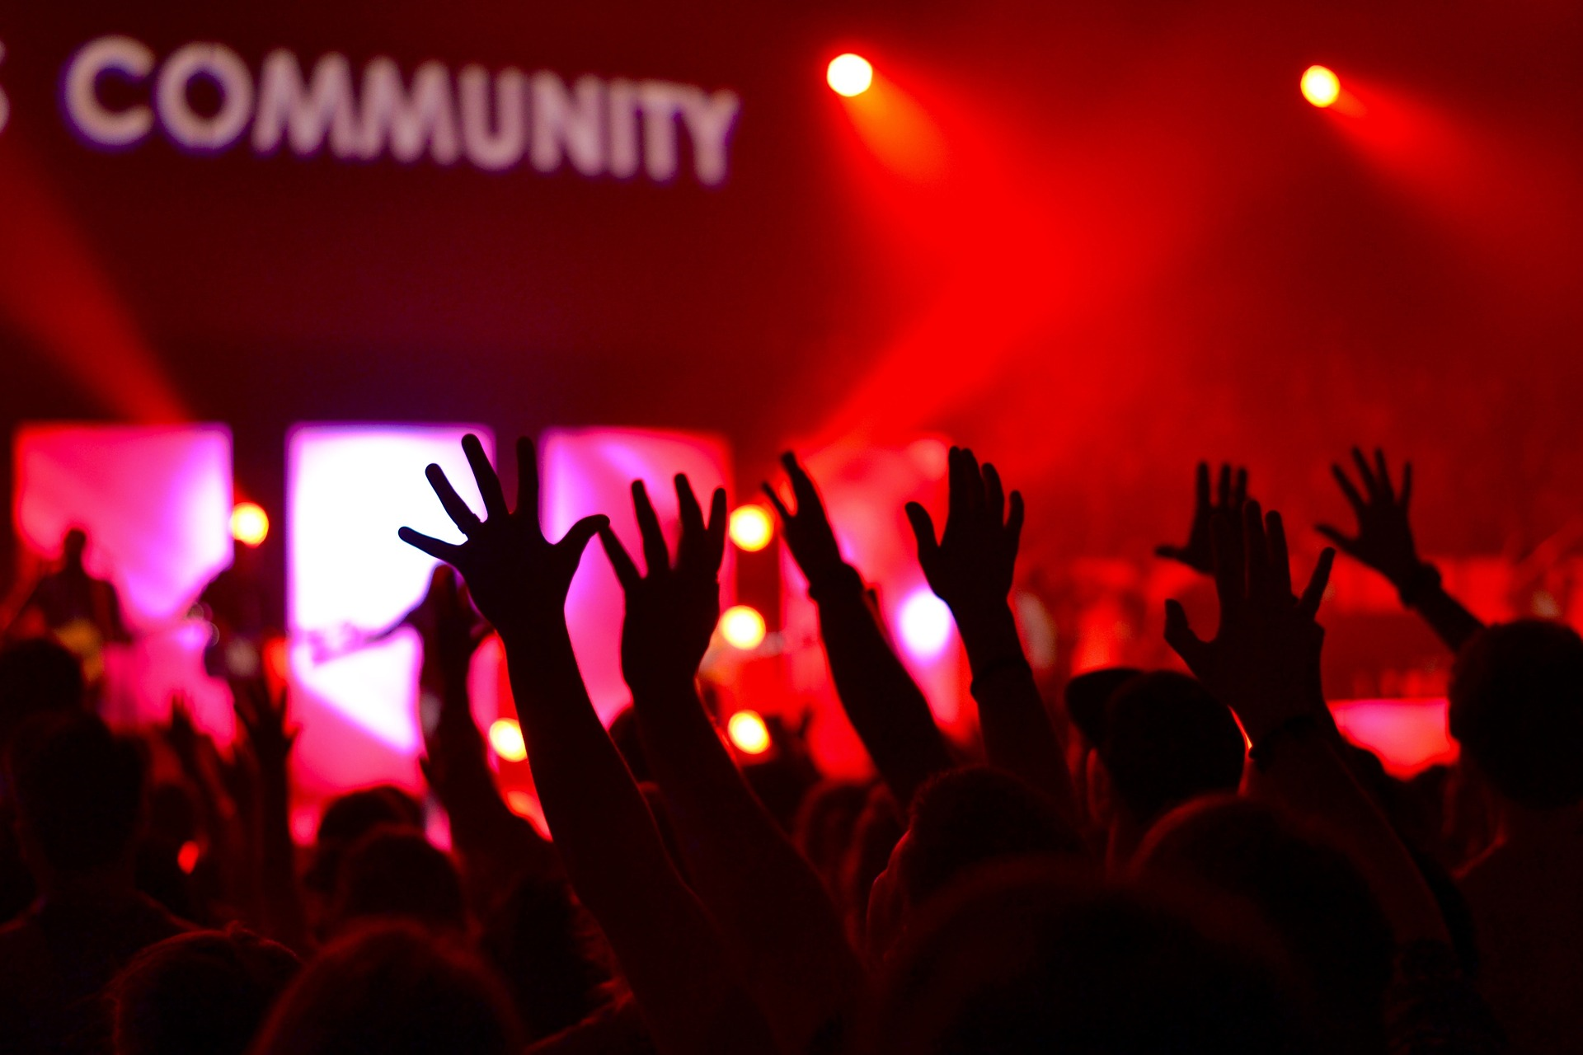
social groups: benefits
expressive & emotional reasons
→ provide companionship & love & security

Slide 5
instrumental leadership
achieving goals
+ productivity
- alienate members

Slide 6
expressive leadership
maintaining group cohesion
+ relationships
- lacking efficiency

Slide 7
styles
authoritarian
democratic
laissez-faire

Slide 8
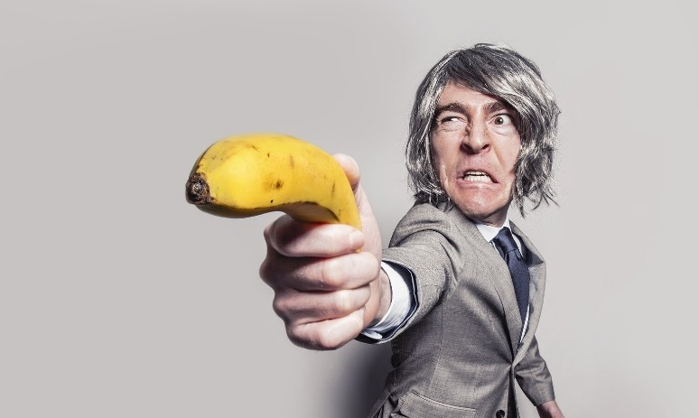
authoritarian
tell what & how to do it
+ a decision needs to be made quickly
+ in a particularly stressful situation
- leads to reduced group member satisfaction

Slide 9
democratic
sharing the decision-making & practicing social equality
+ most effective style → higher productivity
+ better contributions from all members → increased group moral
- leads to communication failures & uncompleted projects

Slide 10
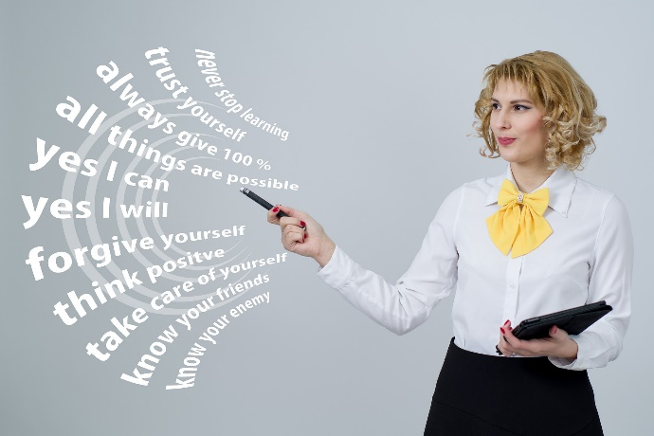
laissez-faire
all the rights & power to make decisions is fully given to the followers – only offering guidance & support
+ for already effective groups
+ experts → more knowledge than group leader
- leads to lower member satisfaction if no feedback is provided

Slide 11
problem solving
discovering problems
asking questions about the problem
clarifying success criteria
encouraging ideas
keeping positive
empathizing with others
expressing concerns
talking about solutions

Slide 12
motivation
motivating the team
showing recognition
dealing with conflicts
Getting everyone involved
asking for input
conforming agreements
setting up effective processes
agreeing on a code of conduct
building trust & relationships

Slide 13
teamwork - feedback
feedback
explaining your role
being supportive
agreeing & disagreeing
showing appreciation
asking for feedback
giving advice
talking about performance

Slide 14
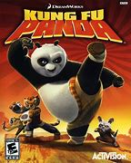
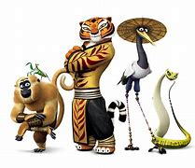
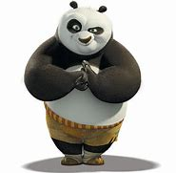
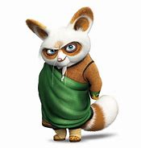
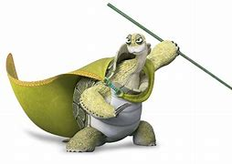
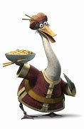
Kung Fu Panda
Tigress, Monkey,
Mantis,
Viper & Crane
Po Panda
Master Shifu
Grand Master
Oogway
Mr Ping

Slide 15
Kung Fu Panda
authoritarian
democratic
laissez-faire

